Slide 1
Microsoft Azure: The Big Picture
By Divya Chavan
Originally Created by Matt Milner
Source: PluralSight

Slide 2
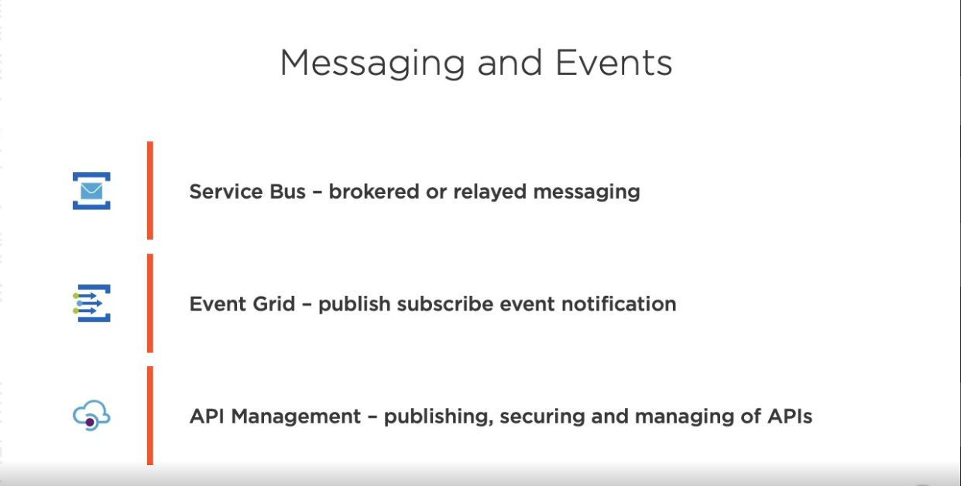
1. Course Overview
There are 50+ services that are included in this course.

Slide 3
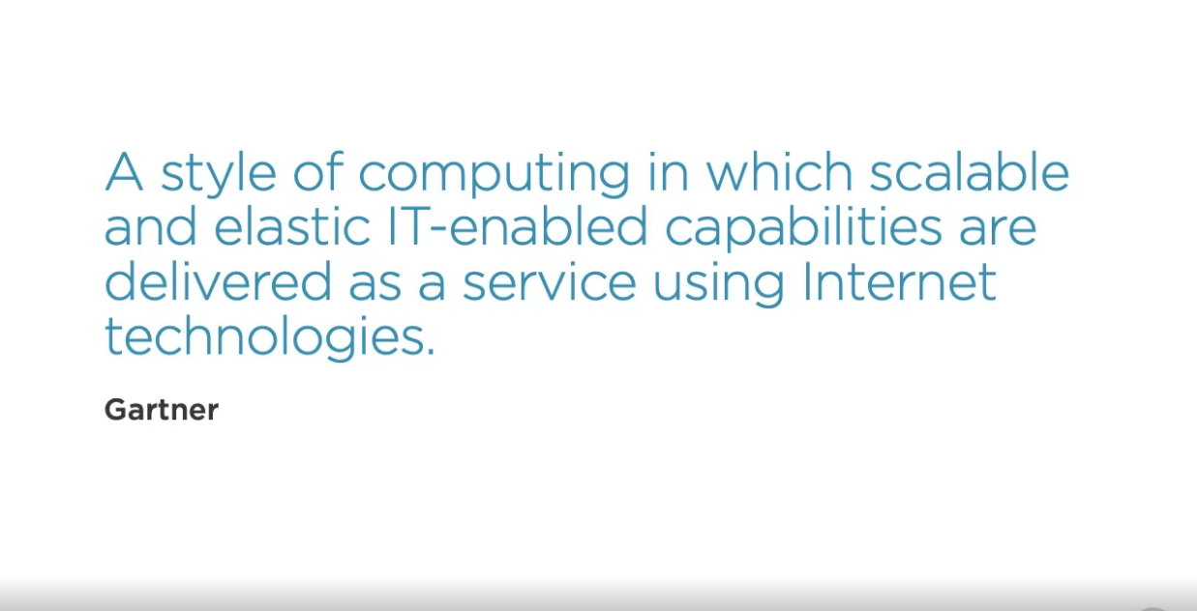
2. Understanding Microsoft Azure: A. Understanding Cloud Computing
Using Compute and Data Storage in other Data Center

Slide 4

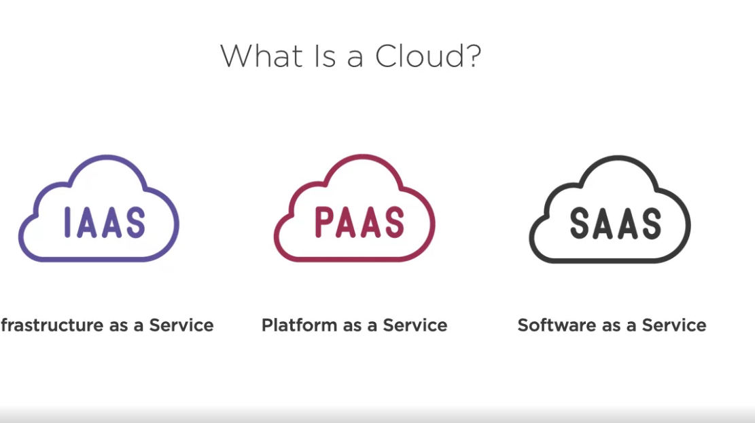
IAAS:
Examples - Virtual Machine, HDD, Networking, IP Address, etc.
PAAS:
Examples – Database and related things.
SAAS:
Gmail, O365, etc.

Slide 5
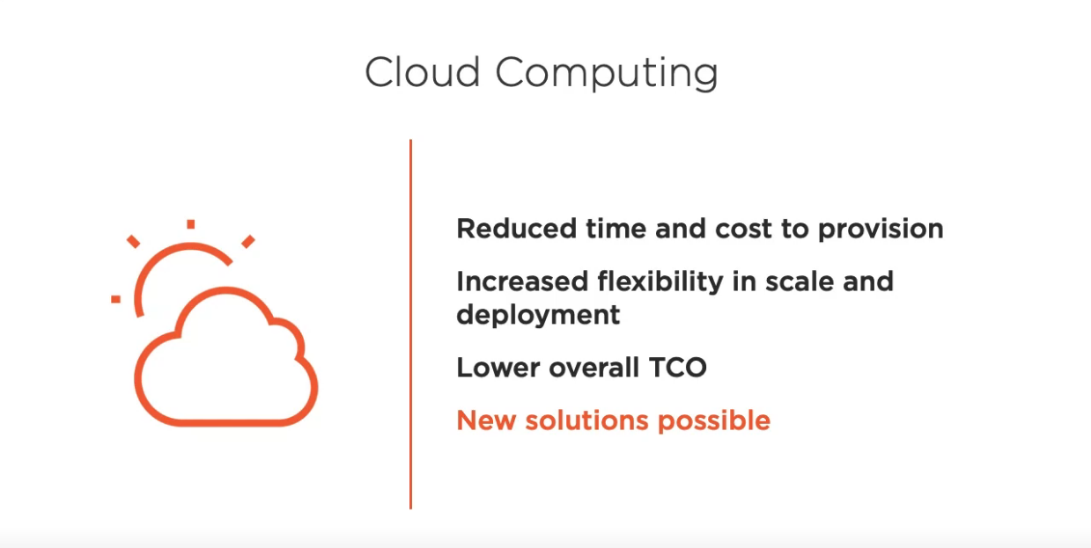
Reduced time and cost.
Increased flexibility
Lower TCO(Total Cost of Ownership).
New Solutions.

Slide 6
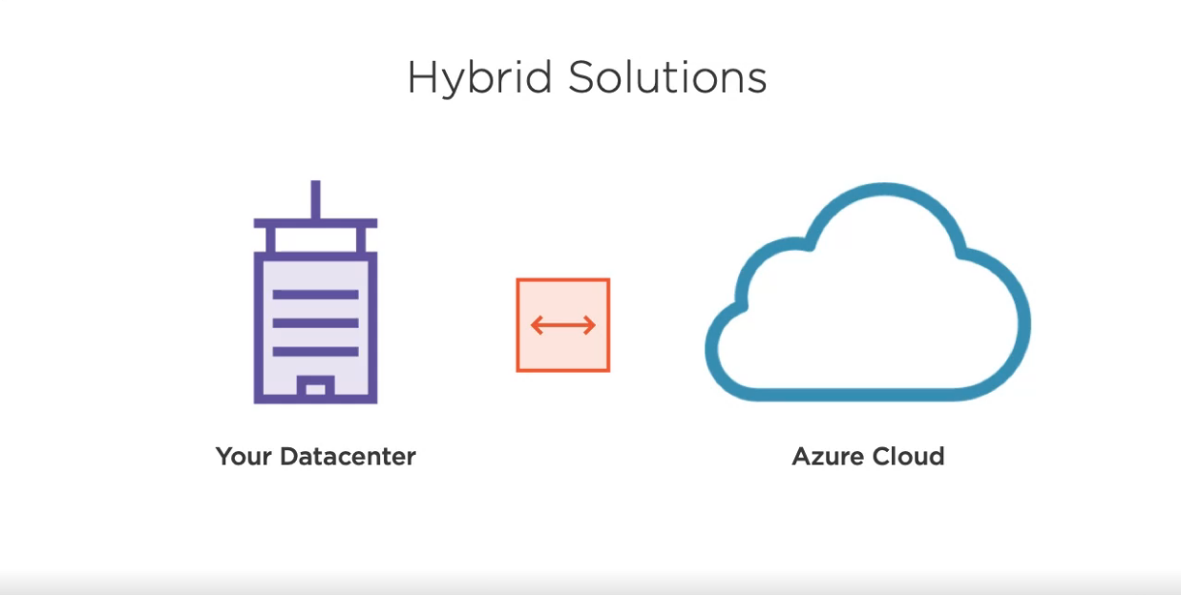
If you move solutions from your Datacenter to the cloud or as you build Hybrid Solution, you can connect those two environments.
So in Hybrid Solutions, you can really take advantage of a Cloud infrastructure, you can deploy to Azure, but you have connections back to the datacenter to take advantage of Application Code, Logic and Data.

Slide 7
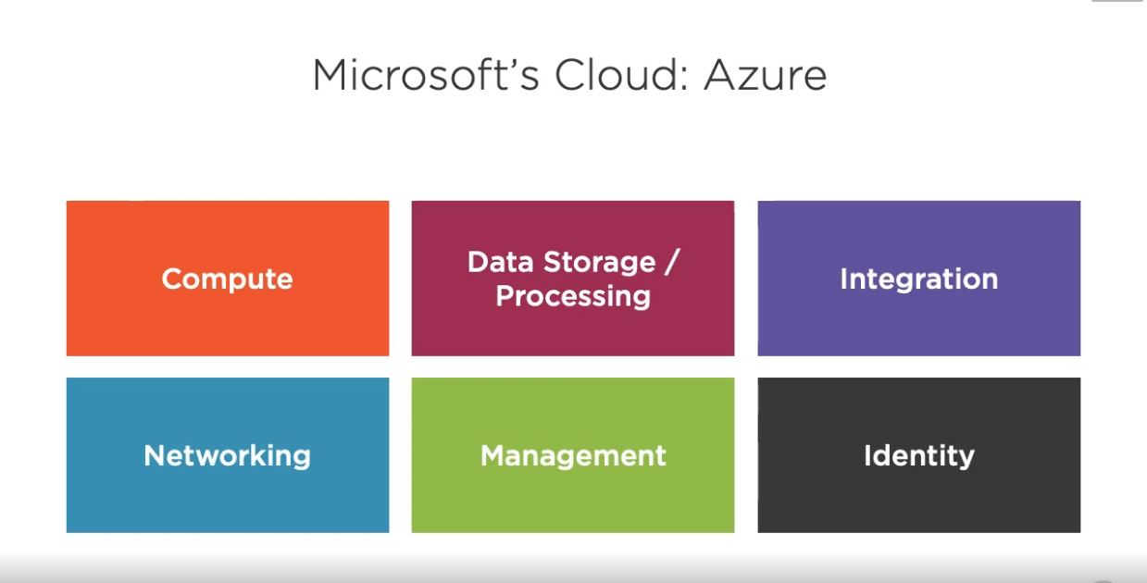
b. Microsoft’s Cloud : Azure
It is basically based on IAAS and PAAS.
It mainly contains following:
Compute
Data Storage/ Processing
Integration
Networking
Management
Identity

Slide 8
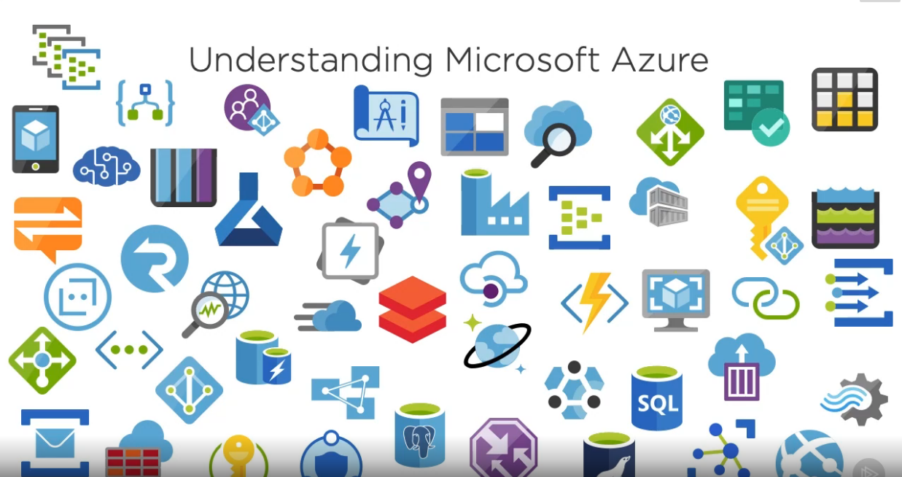
There are plethora of services present in Microsoft Azure.

Slide 9
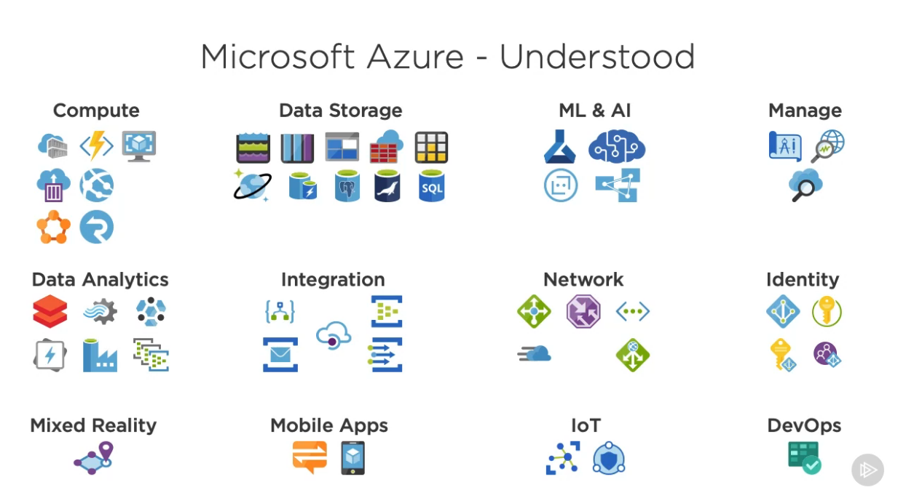
c. Understanding Azure
Services from previous slides have been organized in a group, to know how they relate to each other.

Slide 10
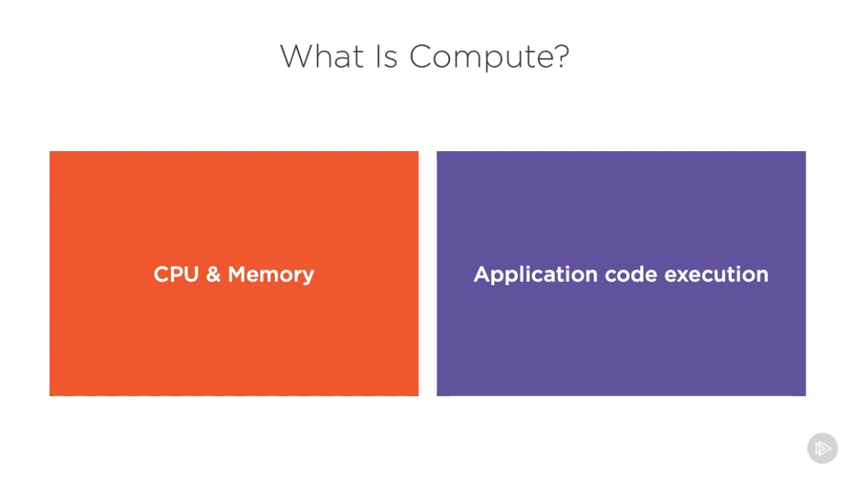
3. Running Code in Azure: Compute: a. Running code: Compute
CPU and the memory that is use to run application code, whether in a form of Virtual Machine or choosing particular scale size or a service such as app service which can host your web application.

Slide 11
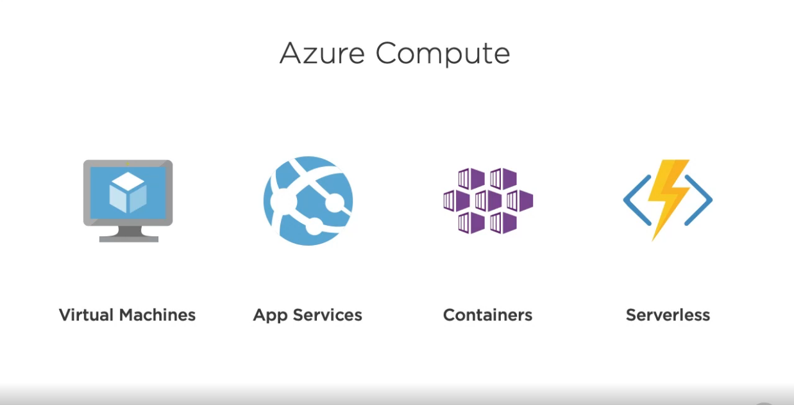
At high level, there are,
Virtual Machines - In computing, a virtual machine is an emulation of a computer system
App Services - Microsoft Azure Web Sites is a cloud computing based platform for hosting websites, created and operated by Microsoft.
Containers - A container is a standard unit of software that packages up code and all its dependencies so the application runs quickly and reliably from one computing environment to another.
Serverless - Serverless computing is a cloud-computing execution model in which the cloud provider runs the server, and dynamically manages the allocation of machine resources.

Slide 12
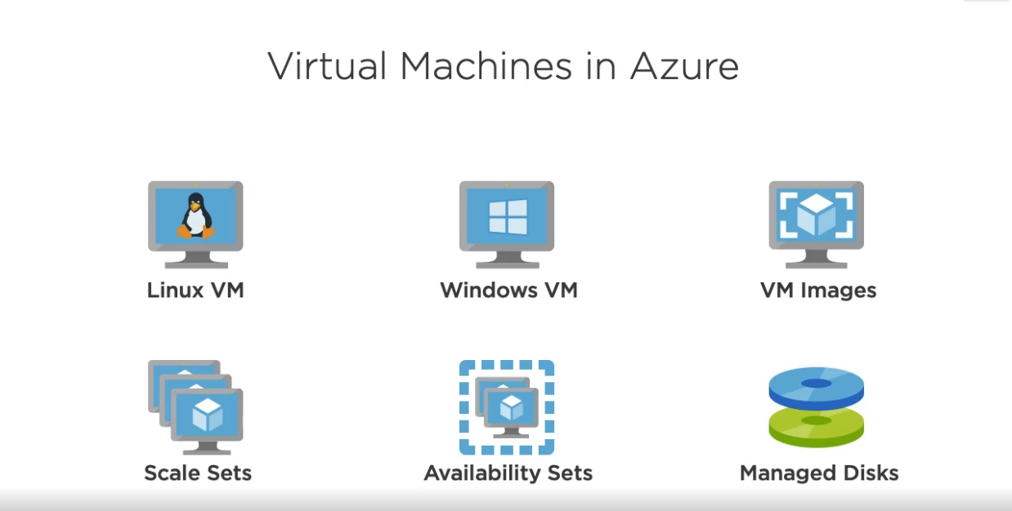
We can create:
Linux VM – to specify drives.
Windows VM – to specify drives.
VM Images – present in .
Scale Sets – to scale load.
Availability Sets – make sure highly available.
Managed Disks – pack up services and network services.

Slide 13
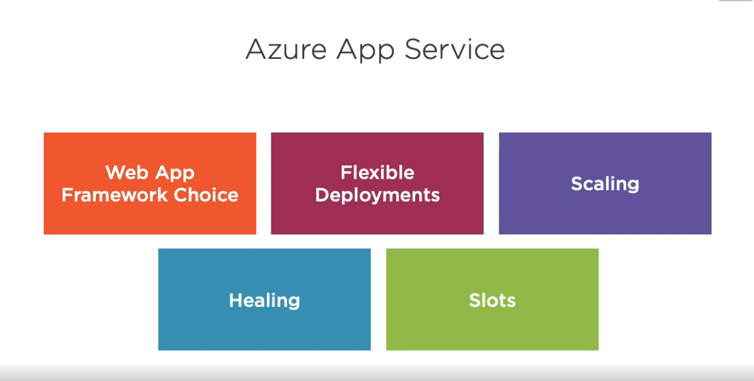
Web App Framework Choice – php, node.js, java, etc.
Flexible Deployment – Integrated Git based, devOps, etc.
Scaling – Can identify web application code.
Healing – If one node is down in Azure, it can take code and deploy on another new node.
Slots – Moving from staging to production environment.

Slide 14
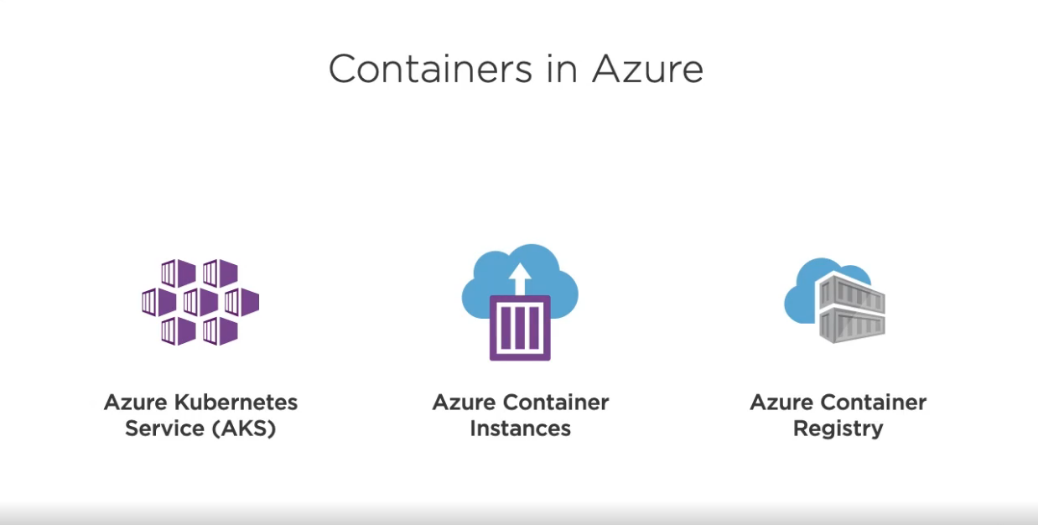
b. Containers, Serverless and more
Azure Kubernetes Services(AKS) – Most commonly used orchestrator for container
Azure Container Instances – Use this with conjunction with AKS called Virtual Nodes.
Azure Container Registry –
Takes container definition
Catalog them into registry.
Make them available for your container instances.

Slide 15
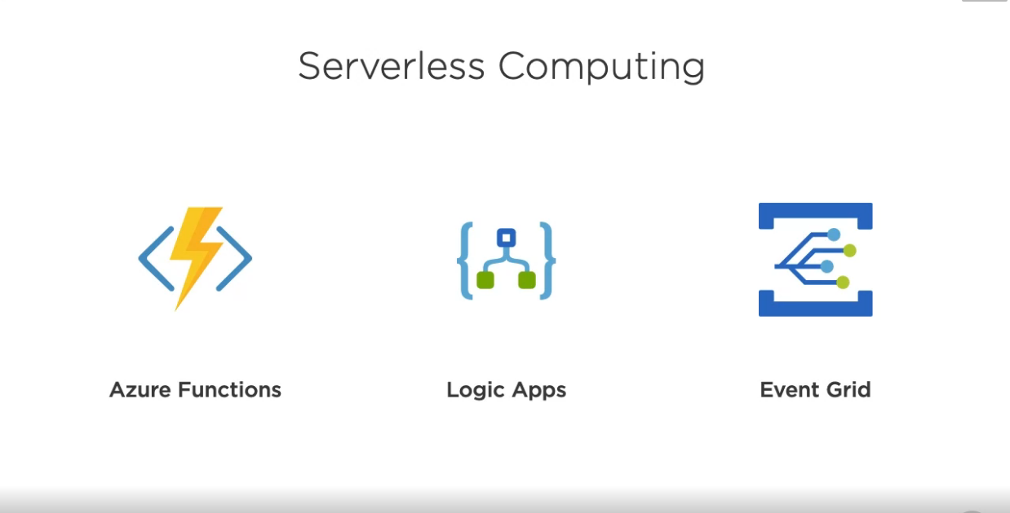
Having code and application execute without having to manage instances, VM or Web application instances.
Offerings –
Azure Functions – Allows you to write the code in form of function using variety of different languages.
Logic Apps – Run without notion of particulars every instances and provide workflow.
Event Grid – which allows you to have very robust mechanism for pub-sub model.

Slide 16
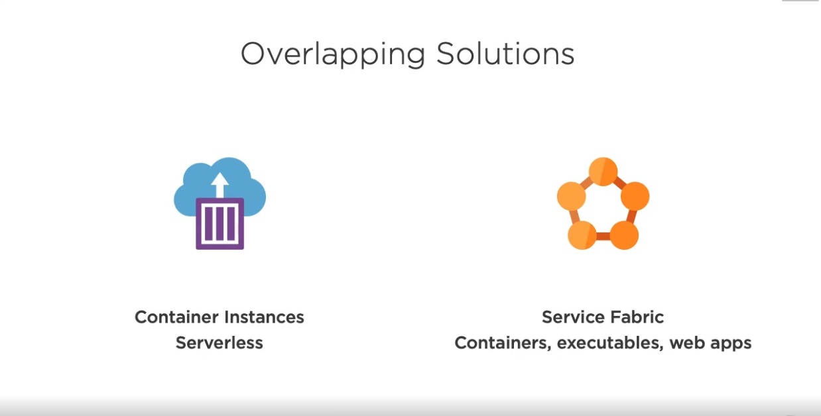
Container Instances – Serverless
Service Fabric – Ties together number of different services in managed diff services in managed infrastructure.

Slide 17
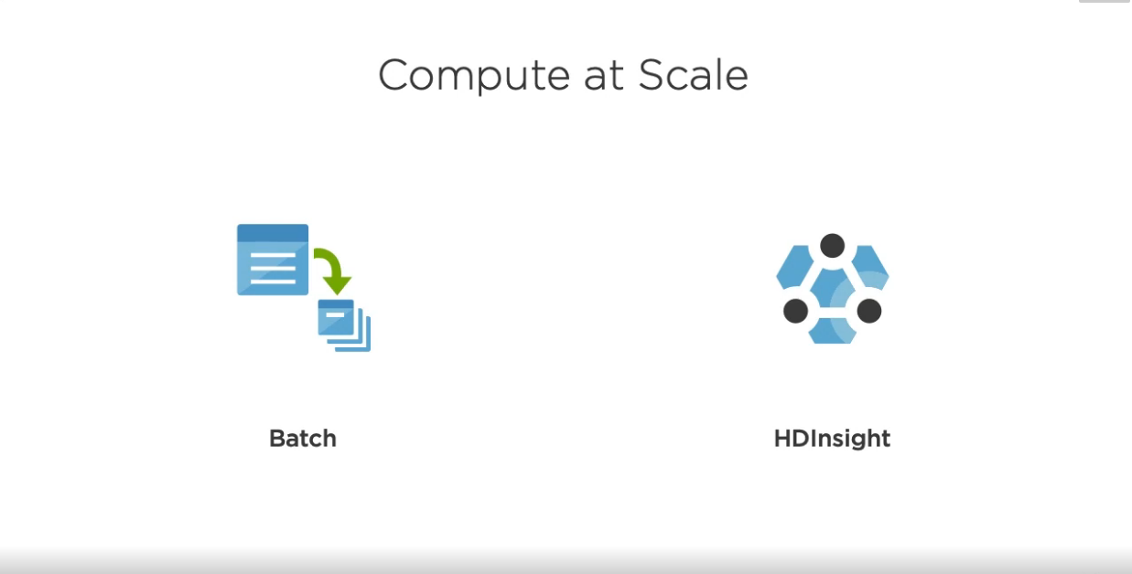
Batch – to set 1000 instances and manages the best workloads that you have.
HDInsight – Inbuilt tool, that is built around open source framework and all sort of processing capabilities around big data and compare that you can take advantage of.

Slide 18
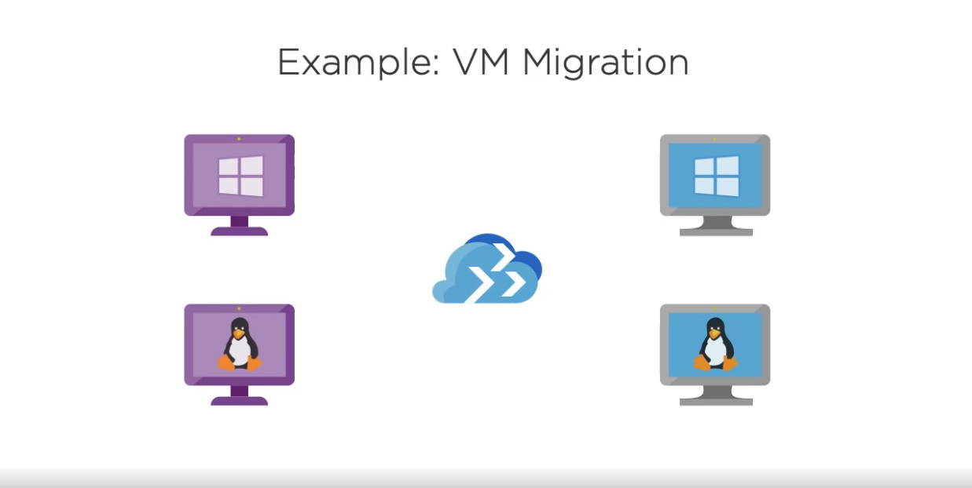
c. Reviewing Compute Examples
1. VM Migration:
By using Azure Migration Tool, that will analyze existing VM upto tens of thousands.
Provides tool and path to migrate those things into Azure.

Slide 19
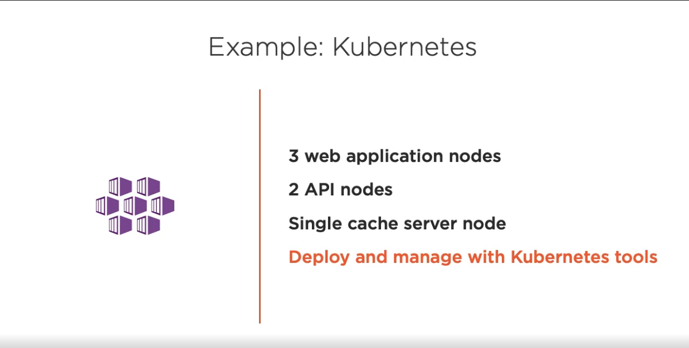
2. Kubernetes:
If you want to build Kubernetes Cluster or want to deploy and manage with Kubernetes tools, manage and deploy in cluster using container technology
You can use all the command line tools from the Kubernetes, or can do local development in Docker, etc.

Slide 20
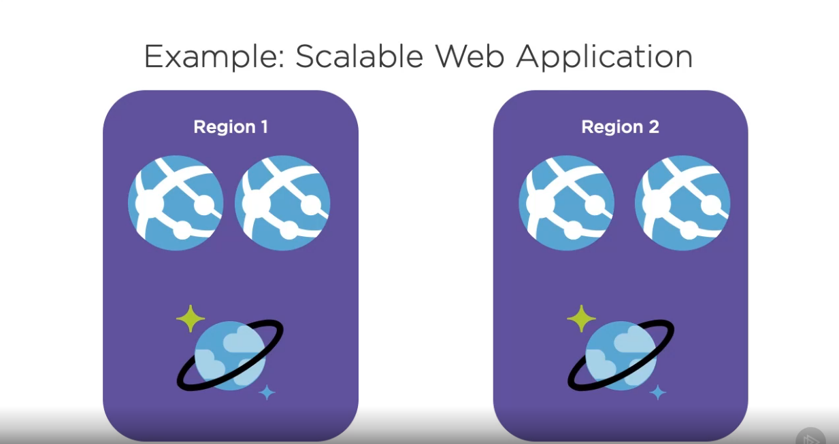
3. Scalable Web Application:
If you want Scalable, global Web Application that’s available in variety of regions.
There are lot of supporting services that may use, such as networking or database or storage services.

Slide 21
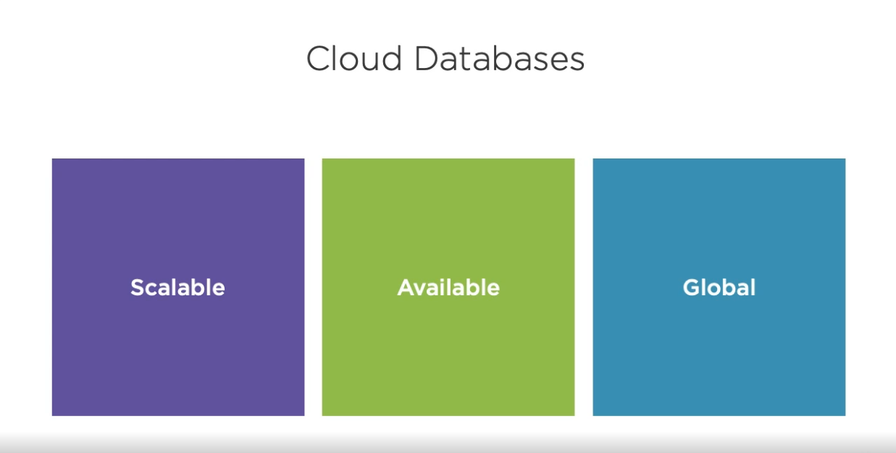
4. Storing and Processing data in Azure: a. Understanding data Storages in Azure
Characteristics:
Scalable – to handle burst loads, large amount of data, large amount of traffic or interactions with the database.
Available – They need to be available i. e. available 24*7.
Global – They need to be global, so we can take advantage of all available services without permission.

Slide 22
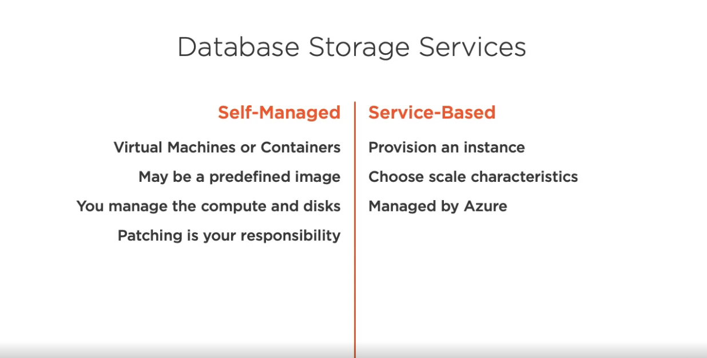
There are 2 options:
Self-Managed – that is we can manage by our own.
Example – VM or Containers, Predefined image, Compute and disks, etc.
Service-Based – that is managed by Azure.

Slide 23
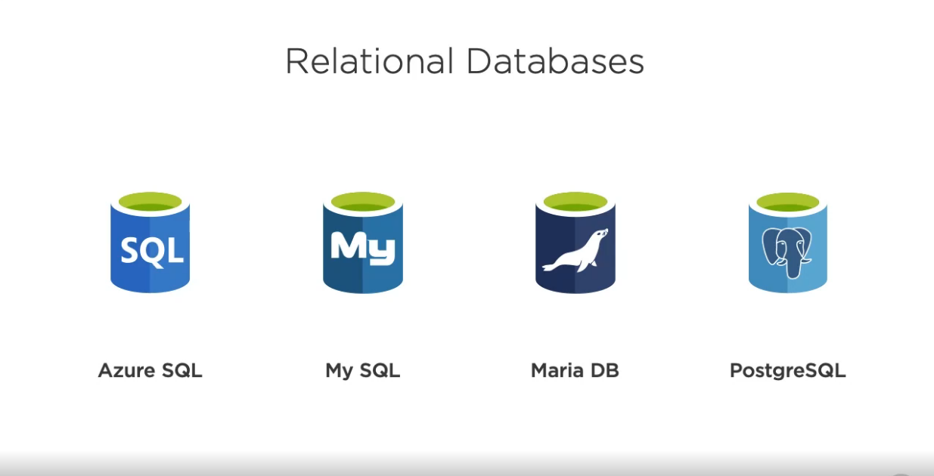
b. Exploring data storage options
Relational Databases:
Azure SQL - Microsoft Azure SQL Database is a managed cloud database provided as part of Microsoft Azure.
My SQL - MySQL is an open-source relational database management system.
Maria DB - MariaDB is a community-developed, commercially supported fork of the MySQL relational database management system, intended to remain free and open-source software under the GNU General Public License.
PostgreSQL - PostgreSQL, also known as Postgres, is a free and open-source relational database management system emphasizing extensibility and technical standards compliance.

Slide 24
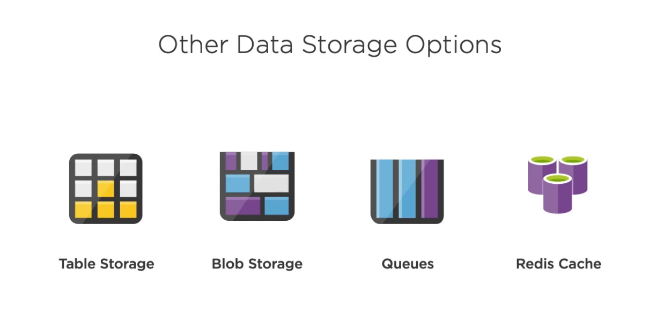
Other Data Storage options:
Table Storage - Azure Table storage is a service that stores structured NoSQL data in the cloud, providing a key/attribute store with a schemaless design.
Blob Storage - A Binary Large OBject (BLOB) is a collection of binary data stored as a single entity in a database management system.
Queues - Azure Queue Storage is a service for storing large numbers of messages. You access messages from anywhere in the world via authenticated calls using HTTP or HTTPS.
Redis Cache - Azure Redis Cache is based on this popular database, providing a powerful and secure way to cache your application's data in the Azure cloud.

Slide 25
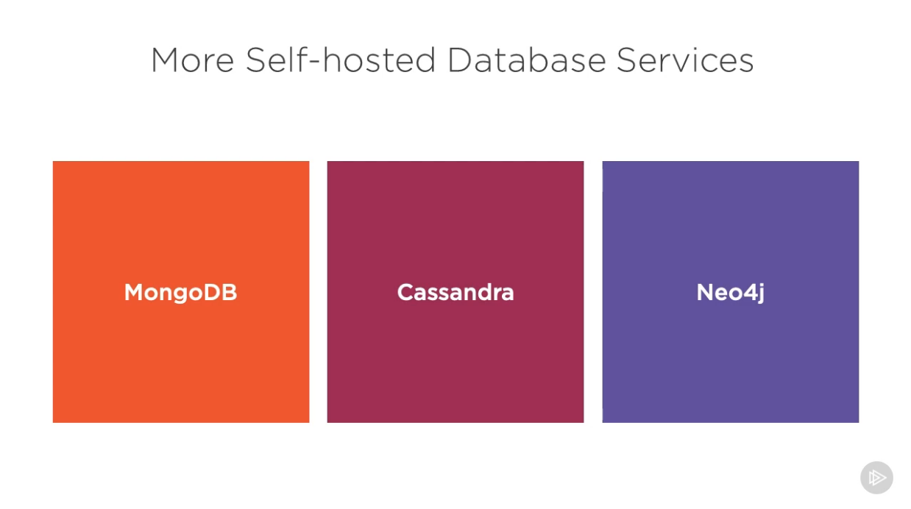
More Self-hosted Database Services:
MongoDB - MongoDB is a cross-platform document-oriented database program. Classified as a NoSQL database program, MongoDB uses JSON-like documents with schema.
Cassandra - Apache Cassandra is a free and open-source, distributed, wide column store, NoSQL database management system designed to handle large amounts of data across many commodity servers, providing high availability with no single point of failure.
Neo4j - Neo4j is a graph database management system.

Slide 26
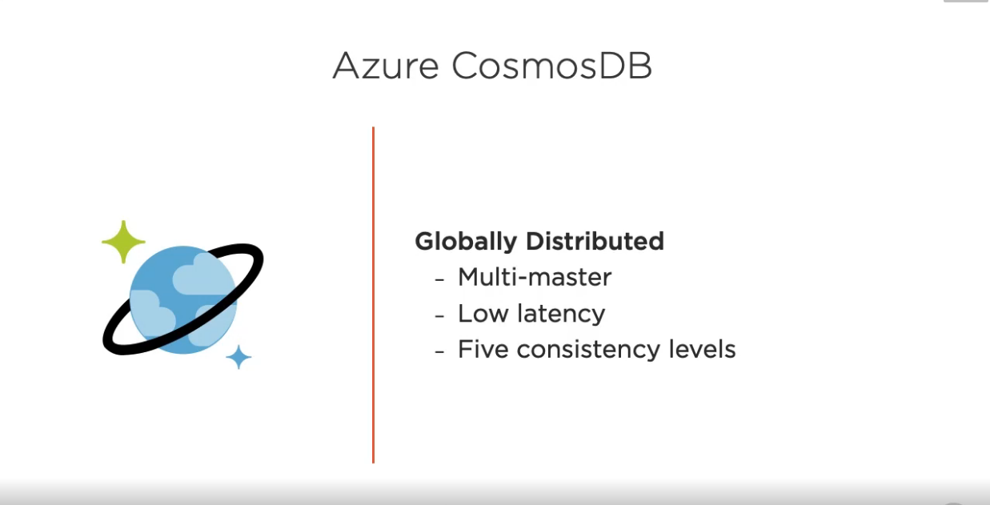
Azure CosmosDB:
Azure Cosmos DB is Microsoft’s proprietary globally-distributed, multi-model database service "for managing data at planet-scale" launched in May 2017.
It is schema-agnostic, horizontally scalable and generally classified as a NoSQL database.

Slide 27
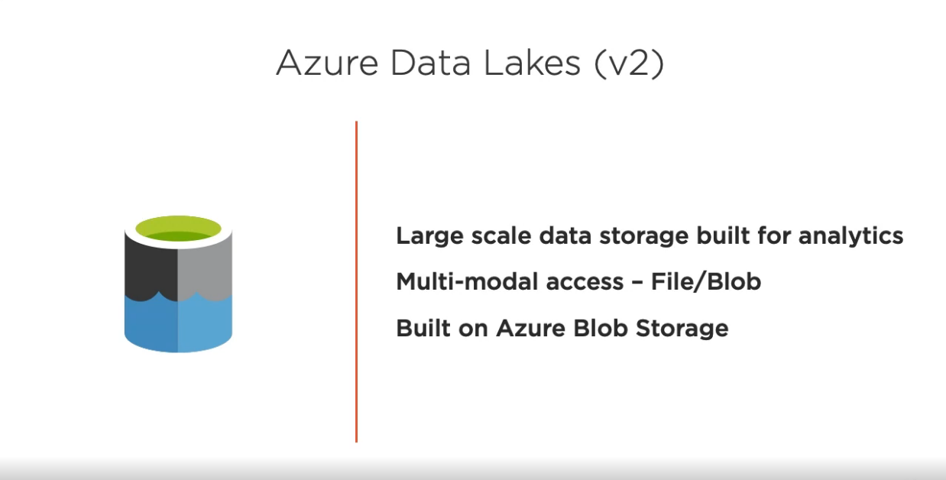
Azure Data Lakes(v2):
Azure Data Lake is a scalable data storage and analytics service.
The service is hosted in Azure, Microsoft's public cloud.

Slide 28
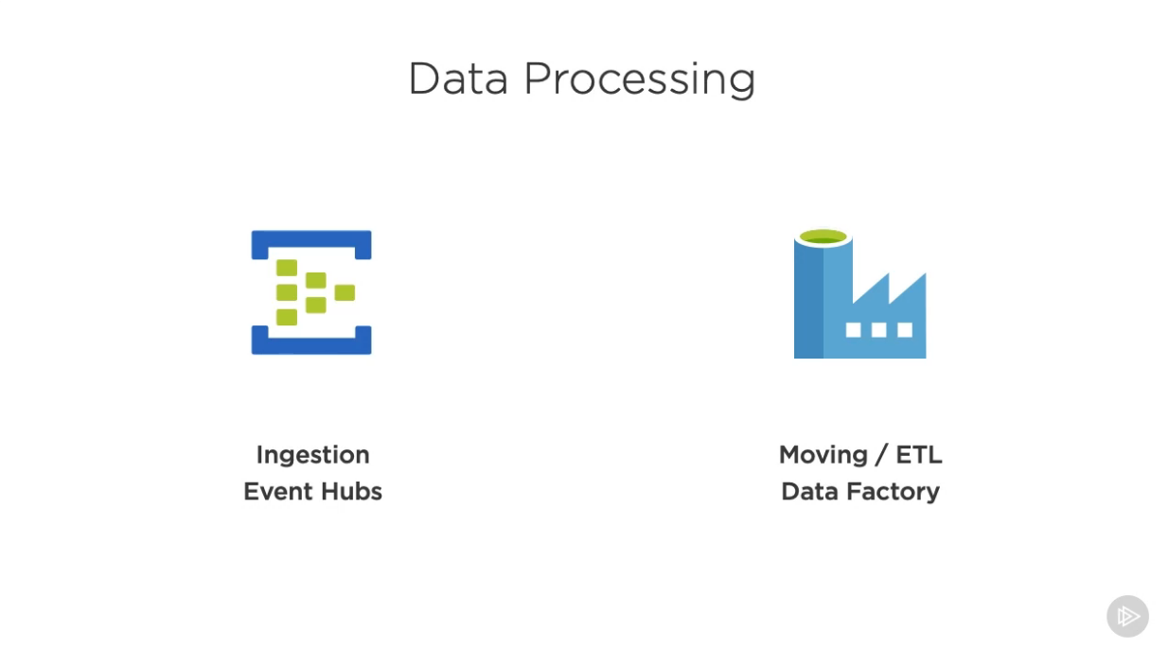
c. Processing Data in Azure
Data processing is done by:
Ingestion Event Hubs – For entering data manually.
Moving / ETL Data Factory – Cloud version of SSIS or DTS in SQL Server.

Slide 29
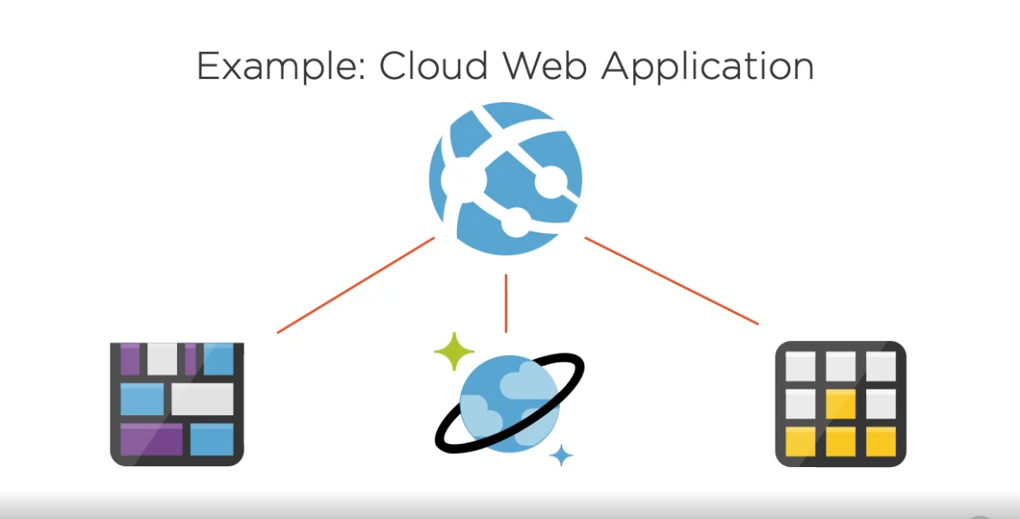
d. Reviewing Data Storage and Processing
1. Cloud Web Application:
Take a simple example of cloud web application, you might store some of the data in Azure Cosmos DB using a document database,
Additionally you may store data in table storage.
And finally you may take advantage of Blob Storage.
All of the above may help you to achieve best performance in your application.

Slide 30
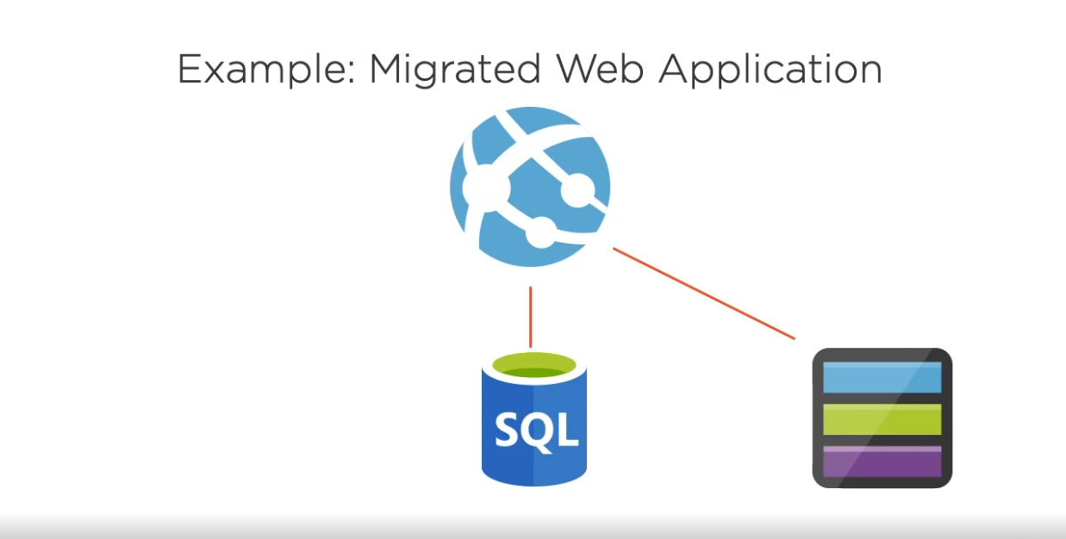
2. Migrated Web Application:
A migrating web application from an inhouse set of web servers and database servers, and you want to move it into Azure.
So you can do that and use Azure SQL as RD Store.
You can take advantage of Azure Storage System and the Azure Files.

Slide 31
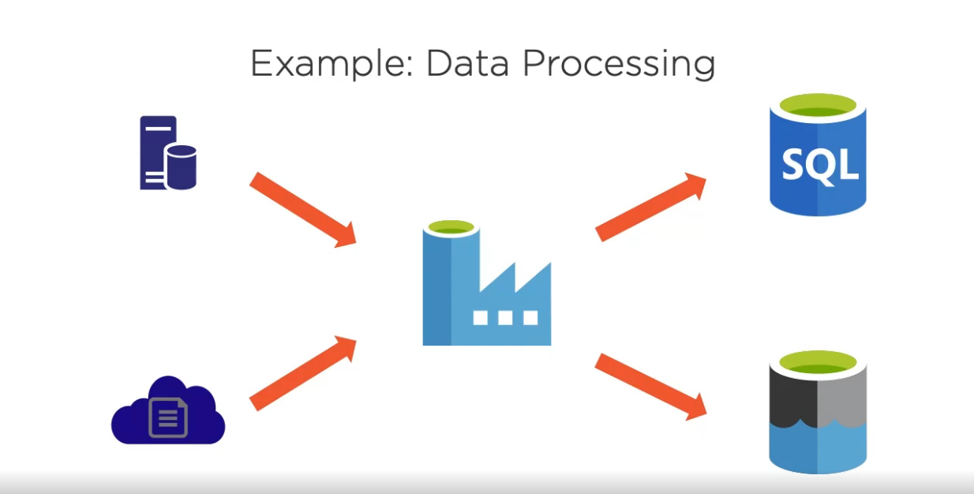
3. Data Processing:
If you are having your data from your own data center and some data from another cloud or another blob, log files or another data and you want to be able to pull all that in and use Azure Data Factory and then to process it.
So then you can pull that data from those sources and then it can send that data off to Azure SQL Database or Data Lake.

Slide 32
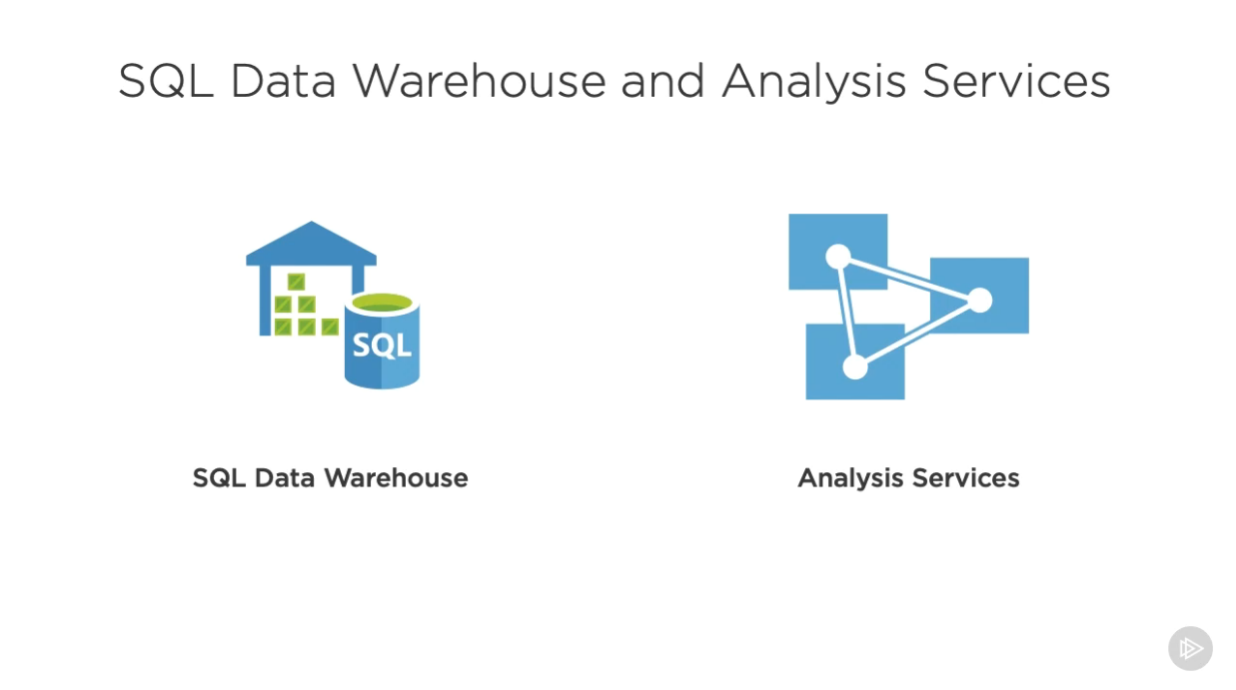
5. Analyzing Data in Azure: a. Analyzing Data
SQL Data Warehouse – It is a Cloud Optimized Data Warehouse. Its storage takes advantage of cloud infrastructure.
Analysis Services – It is used to build projects, manipulate it and create models.

Slide 33
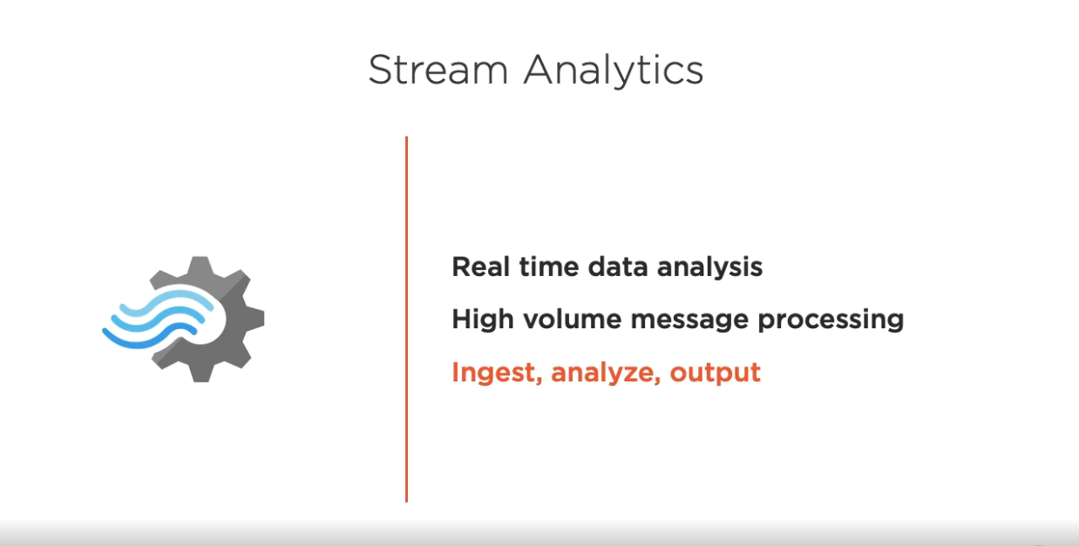
It is Real Time data analysis.
It processes high volume messages.
It performs: Ingest, Analyze and Output.

Slide 34
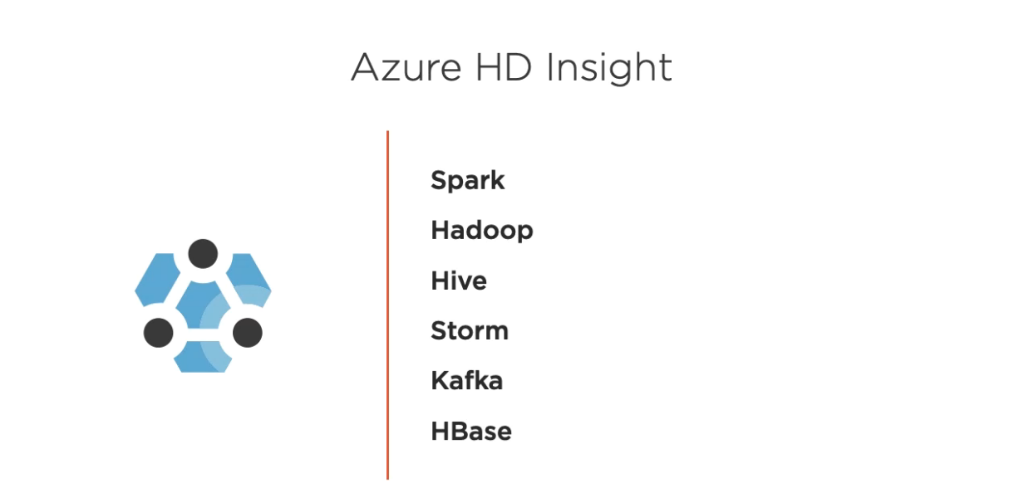
It contains following:
Spark – To run Cluster
Hadoop - The Apache Hadoop cluster type in Azure HDInsight allows you to use HDFS, YARN resource management, and a simple MapReduce programming model to process and analyze batch data in parallel.
Hive – For Interactive Query.
Storm - With Storm on Azure HDInsight, you can create a cloud-based Storm cluster that performs big data analytics in real time.
Kafka - It uses Azure Managed Disks as the backing store for Kafka. Managed Disks can provide up to 16 TB of storage per Kafka broker.
HBase - HiveQL can be used to query data stored in Apache HBase.

Slide 35
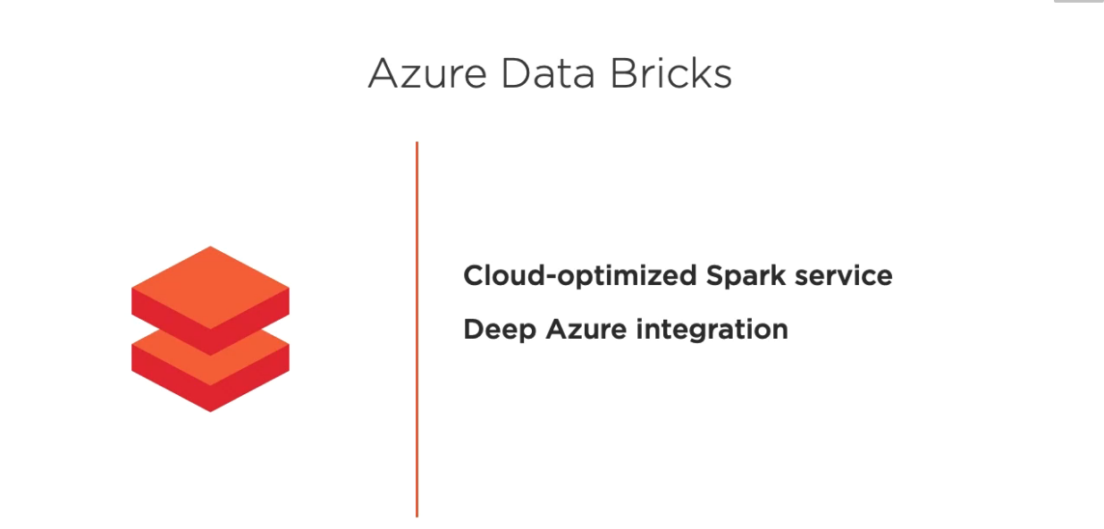
Azure Data Bricks are used to open source framework.
It contains whole open source concepts and focusing on optimizing on cloud.

Slide 36
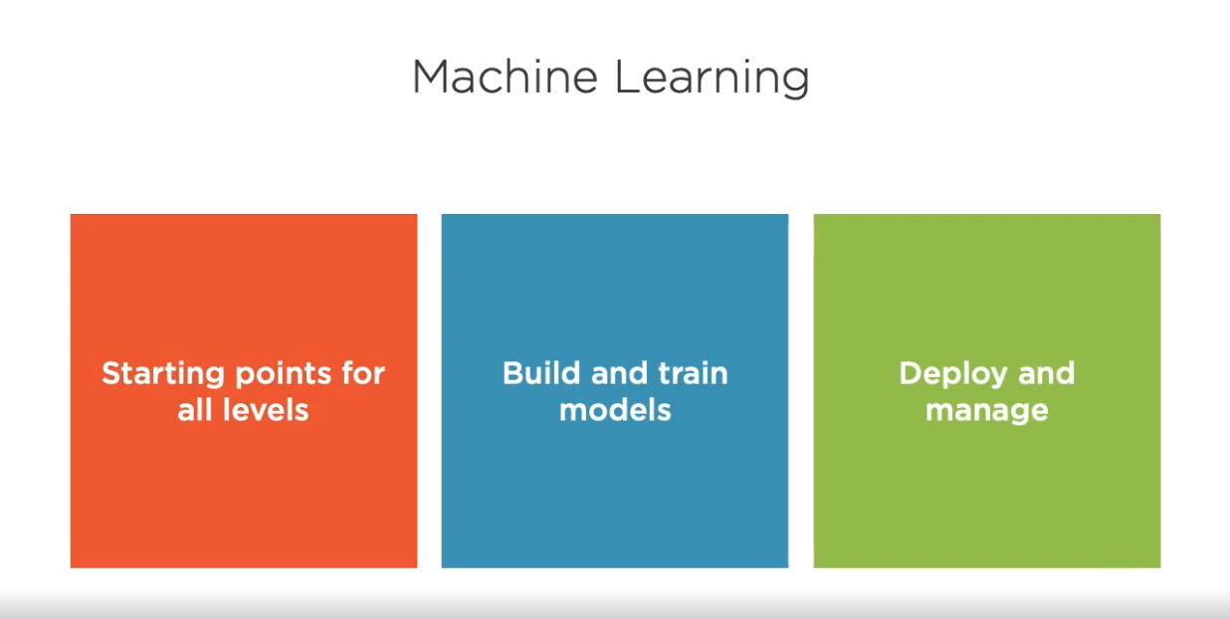
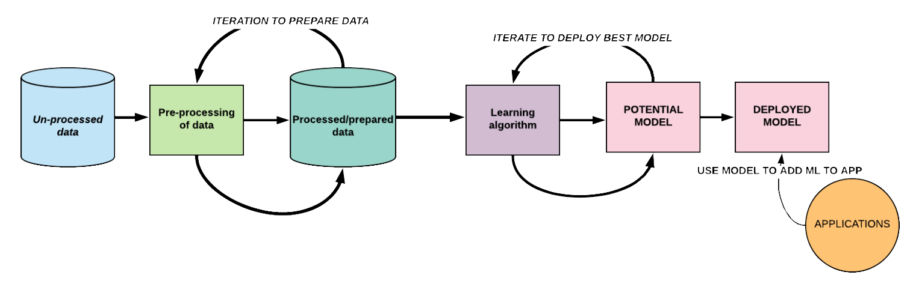
b. Machine Learning and Visualization
At a high-level, here’s the workflow(As shown in image below):
1. Ingestion of raw data (for example, information about credit card spending patterns) into a pre-processing system
2. Application of pre-processing methods to data (making the data usable by the system by removing errors, duplicates, etc.)
3. Presenting the prepared data to a learning algorithm
4. Iteration to discover the best model (i.e., the model that produces the most accurate results and the fewest false positives)
5. Selection of a candidate model
6. Deployment of the model
7. Exposure of the model via API to applications (such as the fraud detection engine)

Slide 37
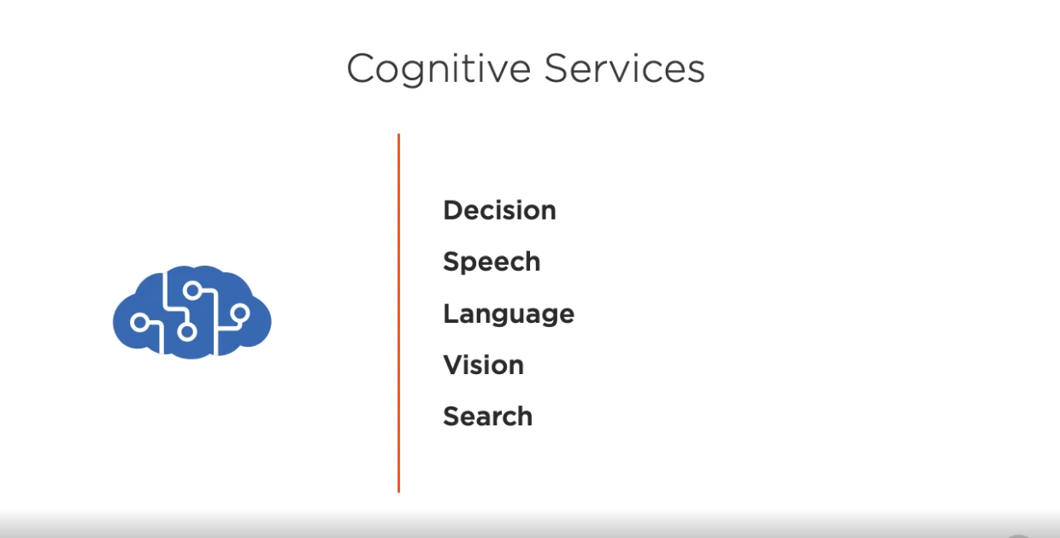
Cognitive Services bring AI within reach of every developer—without requiring machine-learning expertise.
All it takes is an API call to embed the ability to see, hear, speak, search, understand and accelerate decision-making into your apps.

Slide 38
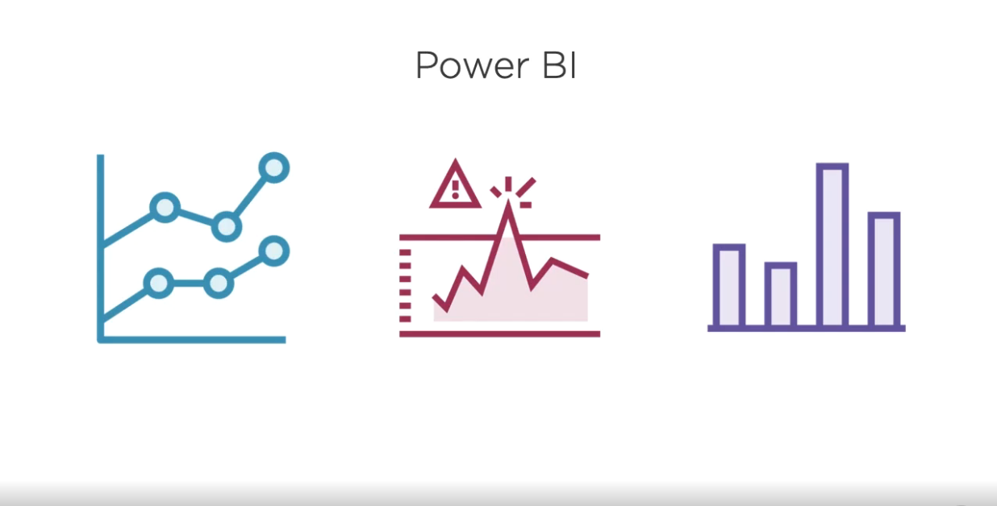
With Azure services and Power BI, you can turn your data processing efforts into analytics and reports that provide real-time insights into your business.
Whether your data processing is cloud-based or on-premises, straightforward, or complex, single-sourced or massively scaled, warehoused, or real-time, Azure and Power BI have the built-in connectivity and integration to bring your business intelligence efforts to life.

Slide 39
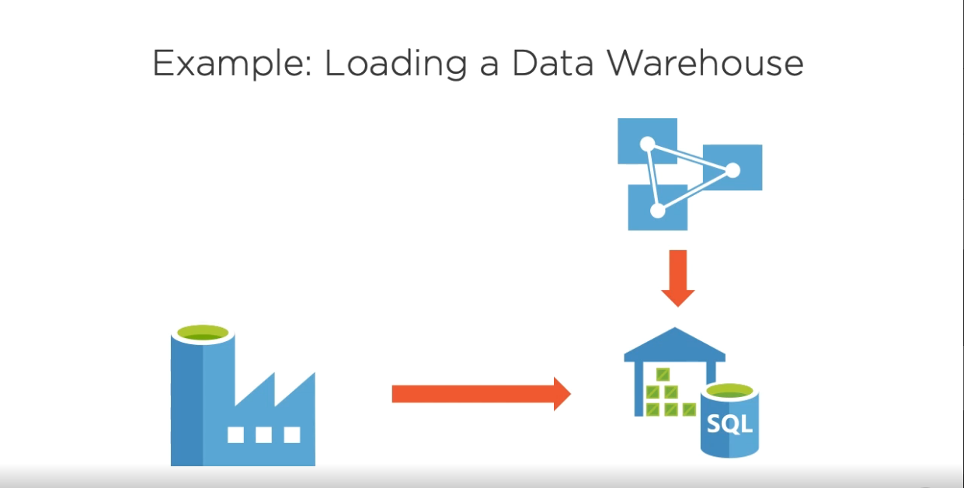
c. Reviewing Data Analytics Examples
1. Loading a Data Warehouse:
To load data from Data Factory into SQL Data Warehouse, Analysis Services at the top of it.

Slide 40
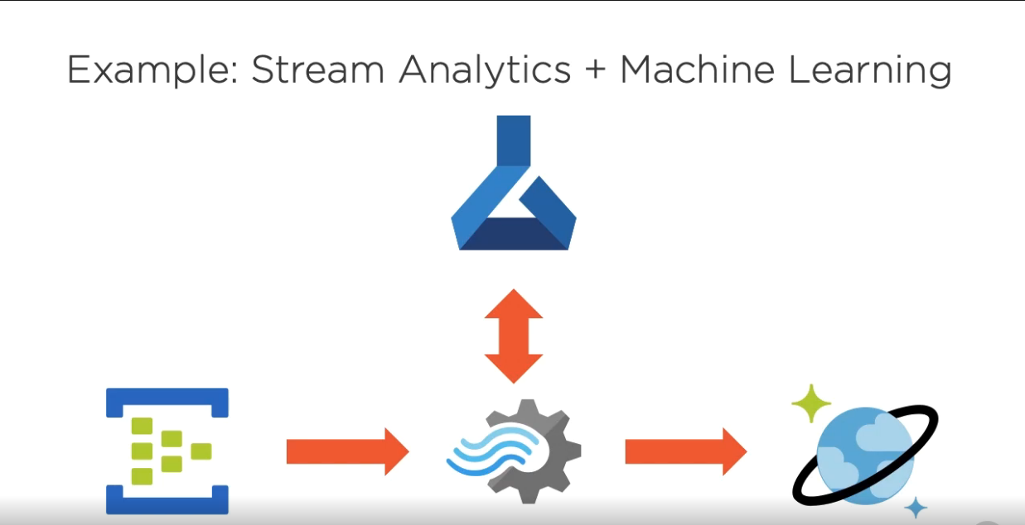
2. Stream Analytics + Machine Learning:
To load data from Event Hub into the Steam Analytics, ML model is provided at the top of it, to load this processed data into Data Store.

Slide 41
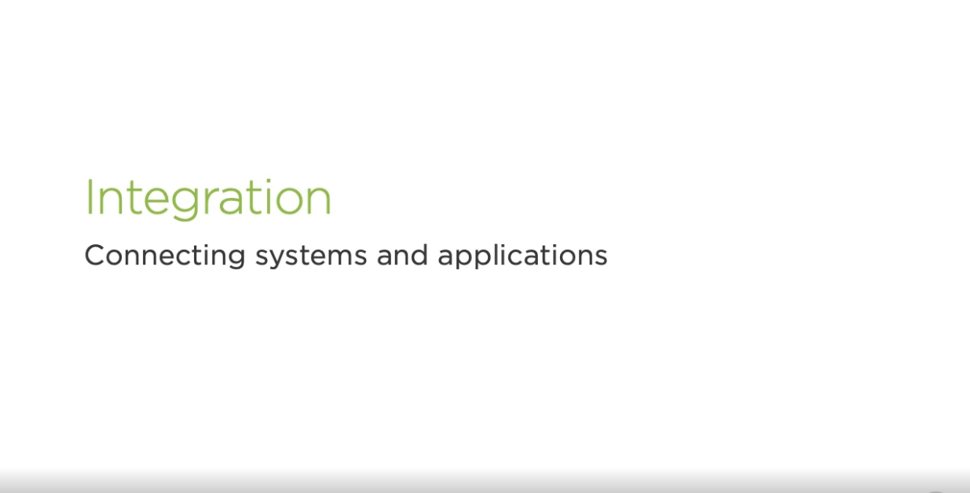
6. Integrating Applications in Azure: a. understanding integration in Azure
Basically Integration is Connecting Systems and Applications.
Azure Integration Services is a collection of services for integrating applications and data.

Slide 42
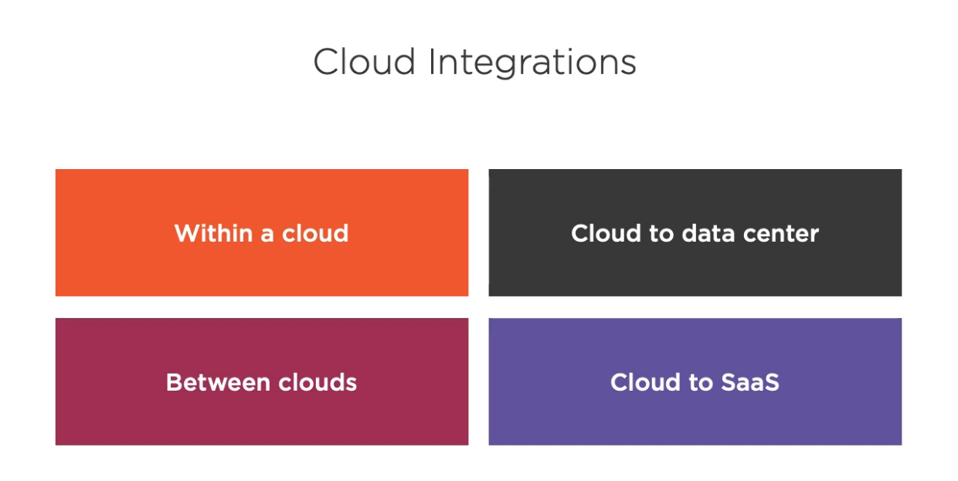
Within a cloud - Own API from a web application or exchanging messages between application nodes.
Cloud to data center - Need to access data in your own data center or you need to be able to send data to your data center.
Between Clouds - One cloud in a region to another cloud in another region, you can say from Amazon to Google cloud etc.
Cloud to SaaS - An application deploying from cloud or need to integrate or connect to one or more SaaS to tale advantage of their functionality.

Slide 43
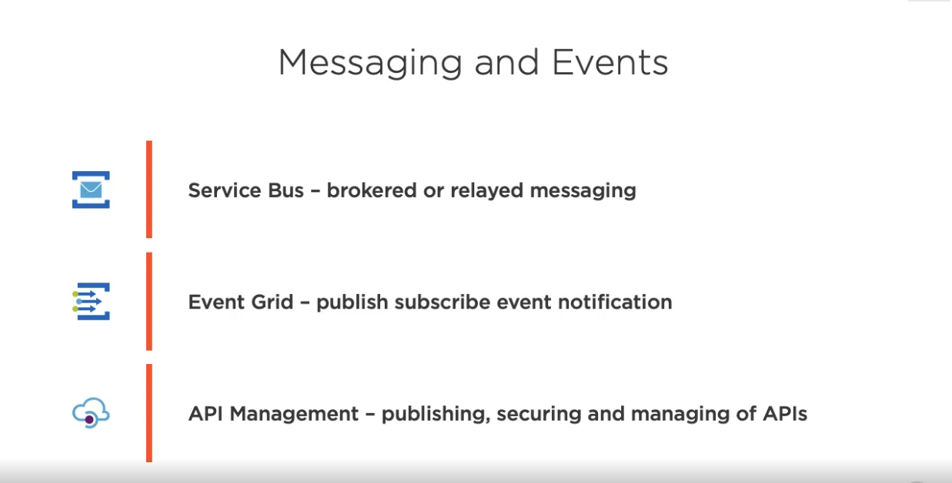
b. Messaging and Workflow
Service Bus – Azure Service Bus is a messaging service on cloud used to connect any applications, devices, and also services running in the cloud to any other applications or services.
Event Grid - Azure Event Grid is a managed event routing platform which enables you to react in real-time to changes that are happening in your applications hosted in Azure or any Azure resources that you own.
API Management - You can use Azure API Management to take any backend and launch a full-fledged API program based on it.

Slide 44
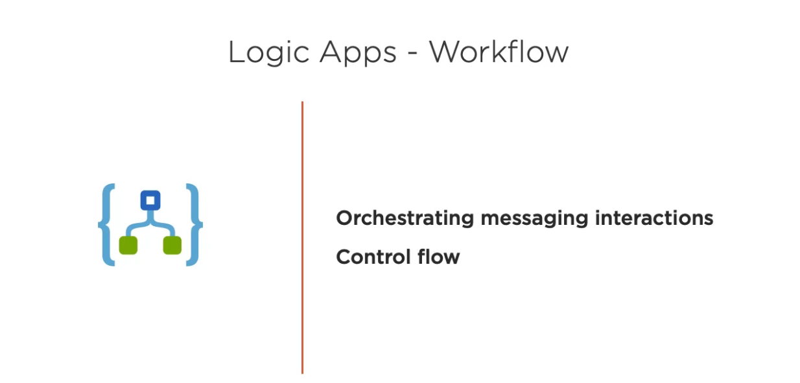
Logic Apps is part of an Azure Subscription and billed on a consumption model.
Flow has a mix of standard and premium connectors.
Premium connector availability is dependent on the licensing level.
Logic Apps have Standard and Enterprise connectors.

Slide 45
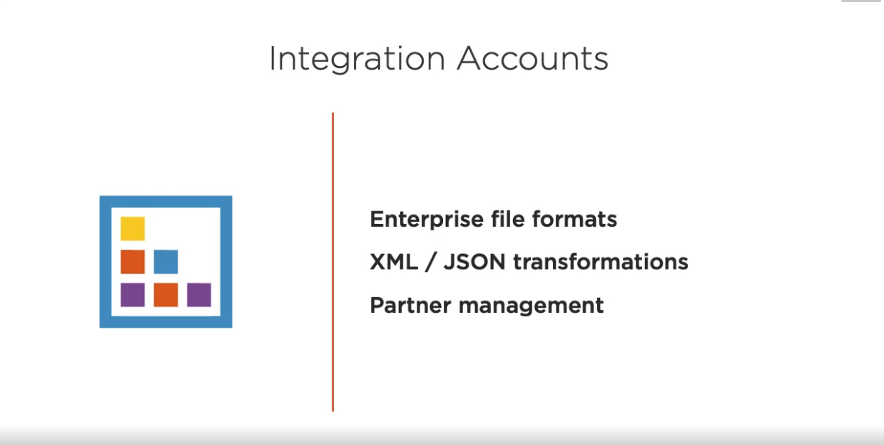
For example, you can create, store, and manage B2B artifacts, such as trading partners, agreements, maps, schemas, certificates, and batch configurations.

Slide 46
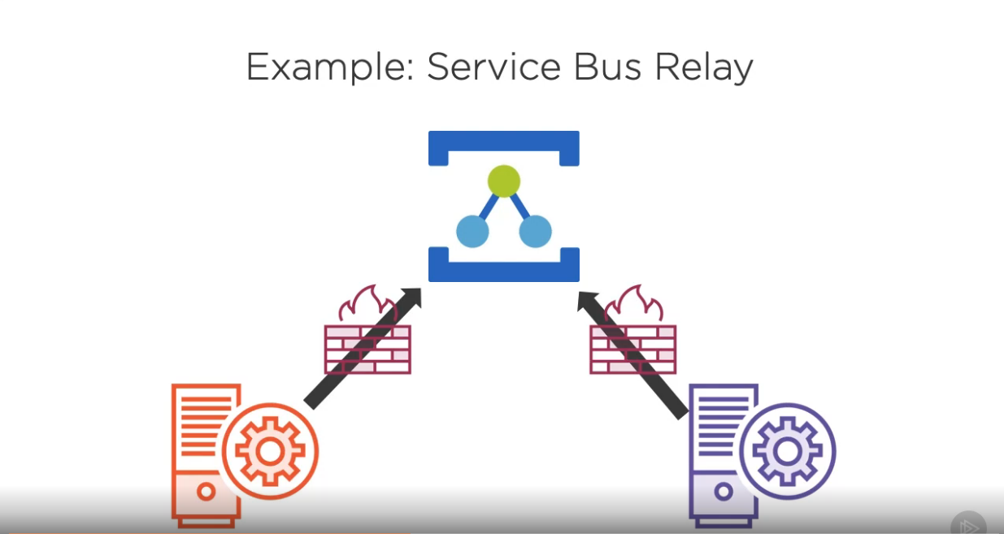
c. Reviewing Integration Examples
Service Bus Relay –
The Azure Service Bus Relay is a technology which is aimed at helping you to create hybrid integration solutions where one you would bridge from a client outside of your organization to access a service inside your network.

Slide 47
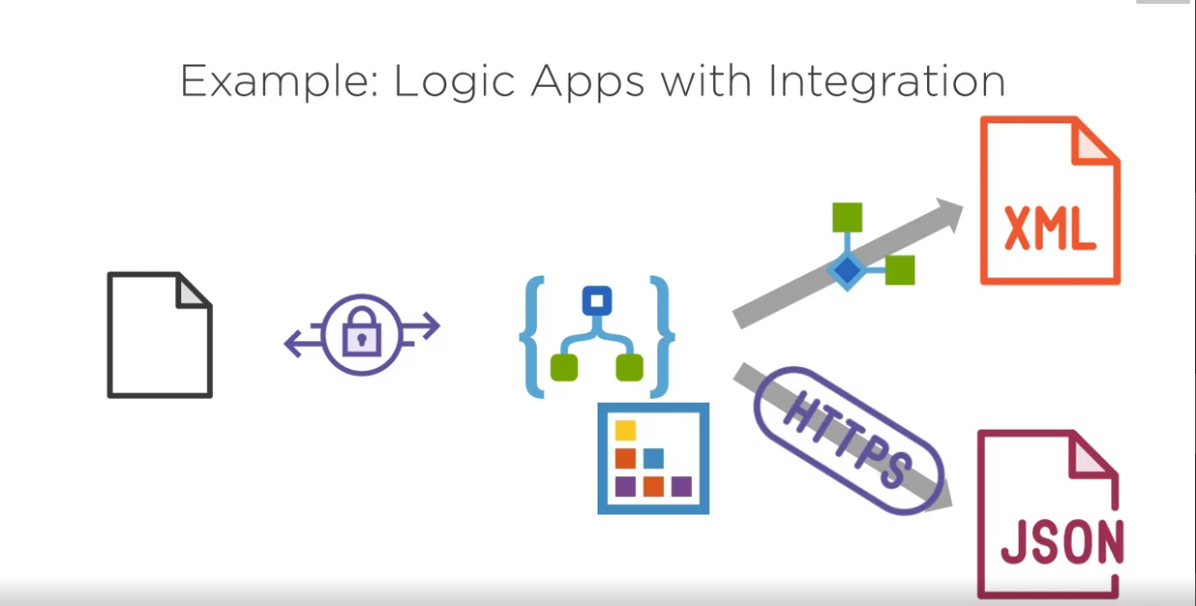
2. Logic Apps with Integration:
Azure Logic Apps provide a mechanism for application integration and workflow definition in the cloud.
It provides a visual designer for configuring the workflows.
You can define a workflow with connectors and logic creation using inbuilt standard connectors and enterprise integration connectors.

Slide 48
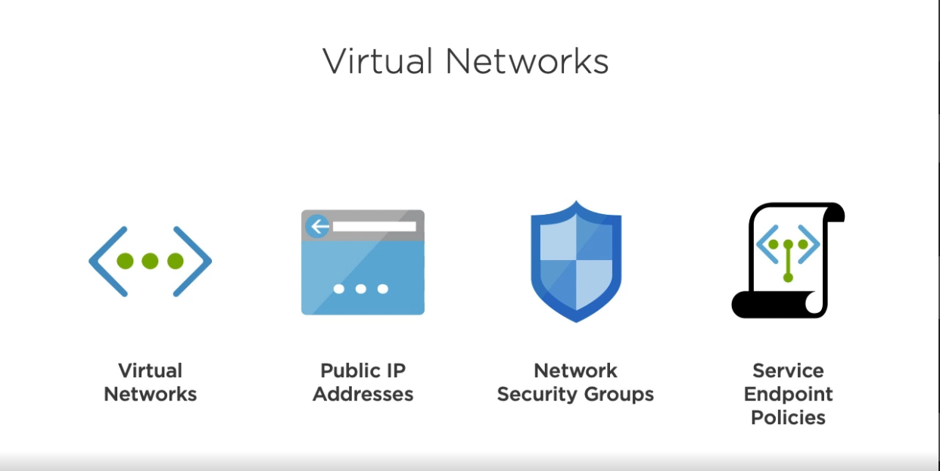
7. Networking In Azure: a. Understanding Azure Networking
Virtual Networks – Azure Virtual Network (VNet) is the fundamental building block for your private network in Azure.
Public IP Addresses – Public IP addresses allow Internet resources to communicate inbound to Azure resources.
Network Security Groups – A network security group contains security rules that allow or deny inbound network traffic to, or outbound network traffic from, several types of Azure resources.
Service Endpoint Policies – VNet service endpoint policies allow you to filter virtual network traffic to Azure services.

Slide 49
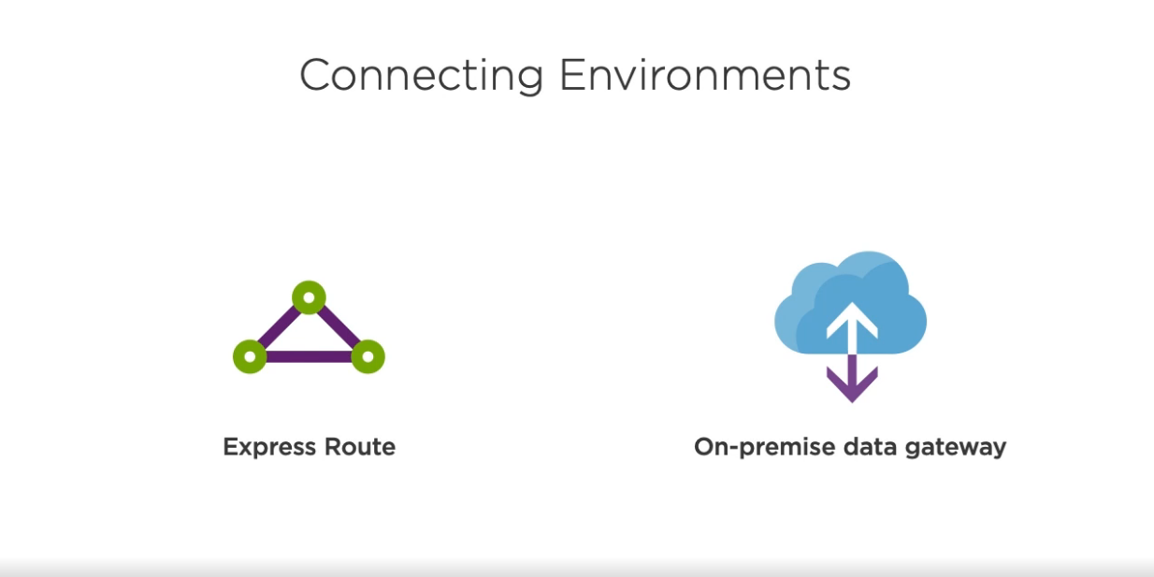
b. Exploring Azure network Service
Express Route – Microsoft Azure ExpressRoute is a service that provides a private connection between an organization's on-premises infrastructure and Microsoft Azure data centers.
On-premise Data Gateway – The on-premises data gateway polls the Azure Service Bus for pending requests.

Slide 50
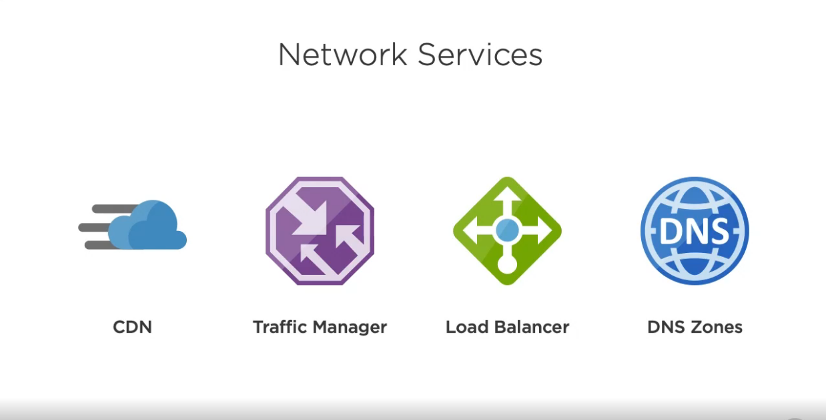
CDN – Azure Content Delivery Network (CDN) is a global CDN solution for delivering high-bandwidth content.
Traffic Manager – Azure Traffic Manager is a DNS-based traffic load balancer that enables you to distribute traffic optimally to services across global Azure regions, while providing high availability and responsiveness.
Load Balancer – An Azure load balancer is a Layer-4 (TCP, UDP) load balancer that provides high availability by distributing incoming traffic among healthy VMs.
DNS Zones – A DNS zone is a data resource that contains the DNS records for a domain name.

Slide 51

DDoS Protection – DDoS Protection enables you to protect your Azure resources from denial of service (DoS) attacks with always-on monitoring and automatic network attack mitigation.
Application Gateway – Azure Application Gateway is a web traffic load balancer that enables you to manage traffic to your web applications.
Front Door – Azure Front Door enables you to build secure, high performant and highly available web applications through global load balancing with fast failover, application acceleration and web application firewall.

Slide 52

c. Reviewing Network Examples
Hybrid Network –
App services, in order to access any organization's datacenter, it may use Express Routes, in order to achieve Hybrid Network.

Slide 53

2. Cloud Web Application –
App services, makes use of Azure SQL database to store cloud web application.

Slide 54

8. Managing and monitoring Azure resources: a. Understanding Azure management
Management refers to the tasks and processes required to maintain your business applications and the resources that support them.
Azure has many services and tools that work together to provide complete management.
These services aren't only for resources in Azure, but also in other clouds and on-premises.

Slide 55

Portal – Users can manage Azure services using the Web-based Azure portal (sometimes referred to as the Azure Resource Manager (ARM) portal)
CLI/PowerShell – Azure CLI is a cross-platform command line tool, that is used to manage and administrate Microsoft Azure. It doesn't replace PowerShell but provides an alternative to using managing Azure from the command line.
Cloud Shell – Azure Cloud Shell is an interactive, authenticated, browser-accessible shell for managing Azure resources. It provides the flexibility of choosing the shell experience that best suits the way you work, either Bash or PowerShell.
Mobile App – Azure App Service is a fully managed PaaS offering for professional developers.

Slide 56

Backup and site recovery – Azure Site Recovery can perform replications for Azure VMs between Azure regions and on-premises VMs, Azure Stack VMs, and physical servers.
Automation and Scheduling – A schedule can be configured to either run once or on a reoccurring hourly or daily schedule for runbooks in the Azure portal.
Policy – Manage cloud policies and compliance assessments for your resources with Azure Policy.
RBAC – Role-based access control (RBAC) is a system that provides fine-grained access management of Azure resources.z

Slide 57

b. Management Tools
Resources in Azure are deployed by:
Azure Resource Manager
Azure Deployment Manager

Slide 58

Monitor – Azure Monitor maximizes the availability and performance of your applications and services by delivering a comprehensive solution for collecting, analyzing, and acting on telemetry from your cloud and on-premises environments.
Network Watcher – Automate remote network monitoring with packet capture.
Alerts – Metric alerts in Azure Monitor provide a way to get notified when one of your metrics cross a threshold.

Slide 59

c. Reviewing Management Examples
1. Deploy and Monitor

Slide 60

2. Automated Updates

Slide 61

9. Developing for Azure: a. Understanding Azure Development
Most services have REST/ Wb APIs
Provides cross-platform access
Client SDKs wrap APIs.
Web Portal provides some development.

Slide 62

SDKs – The Azure SDKs are collections of libraries for programming languages.
Developer Tools – for integrating Azure right into your development environment.
Container Development – Azure Container Instances is a service that enables a developer to deploy containers on the Microsoft Azure public cloud
Build and Deploy – There are various tools that usually considered for development like, Jenkins, GitLab, TeamCity, etc.

Slide 63

There are various languages supported by Azure SDK, like PHP, Python, Node.JS, .NET, Ruby.
Many cross-platform are there.

Slide 64

Visual Studio – Publish directly to Azure, or set up a CI/CD pipeline to build and deploy your code to the cloud.
Eclipse – The Azure Toolkit for Eclipse provides templates and functionality that you can use to easily create, develop, test, and deploy cloud applications to Azure from inside the Eclipse IDE.
Visual Studio Code – Visual Studio Code makes it easy to deploy your applications to Azure and we've created walkthroughs to help you get started.
IntelliJ – The Azure Toolkit for IntelliJ provides templates and functionality that you can use to easily create, develop, test, and deploy Azure applications.

Slide 65

b. Working with Containers and Dockers
Docker – Docker is a popular container management and imaging platform that allows you to quickly work with containers on Linux and Windows.
Cloud Deployment – Develop, package and deploy powerful applications and services to the cloud with Azure Cloud Services and the click of a button.

Slide 66

Azure Dev Spaces – Azure Dev Spaces allows you to test and iteratively develop your entire microservices application in Azure Kubernetes Service (AKS) without replicating or mocking dependencies.

Slide 67

Deloy it using:
Git – Whether you have a few, a dozen or hundreds of Git repositories, Azure DevOps hosts them privately and securely.
ARM templates – Deploy Azure resources through the Azure Resource Manager with community-contributed templates.

Slide 68

Azure Boards – Azure Boards offers Kanban boards, backlogs, and dashboards for flexible work tracking that is fully connected to the code and issues for all your projects – big and small.
Azure Repos – Azure Repos is a set of version control tools that you can use to manage your code.
Azure Pipelines – Azure Pipelines is a cloud service that you can use to automatically build and test your code project and make it available to other users.
Azure Test Plans – Azure Test Plans or the Test hub in Azure DevOps Server (see Web portal navigation) provides three main types of test management artifacts: test plans, test suites, and test cases.

Slide 69

c. Reviewing Development Examples
1. Developing Node.js in VS Code

Slide 70

2. Creating a Microservice Solution

Slide 71

10. Using identity and Security in Azure: a. Understanding Identity and Security
Azure Active Directory (Azure AD) is Microsoft's cloud-based identity and access management service, which helps your employees sign in and access resources in: External resources, such as Microsoft Office 365, the Azure portal, and thousands of other SaaS applications.

Slide 72

To provide identity services to applications and VMs in the cloud, Azure AD DS is fully compatible with a traditional AD DS environment for operations such as domain-join, secure LDAP (LDAPS), Group Policy and DNS management, and LDAP bind and read support.

Slide 73

Managed Identities – Managed identities for Azure resources is a feature of Azure Active Directory.
Application Registrations – Registering the application means that your developers can use Azure AD to authenticate users and request access to user resources.
Enterprise Application – Enterprise apps are apps that are deployed and used within your organization and you can manage single sign-on settings for them by azure portal.

Slide 74

b. Data Protection and Monitoring
Information Protection – Control and help secure email, documents, and sensitive data inside and outside your company walls.
Key vault – Use Azure Key Vault to encrypt keys and small secrets like passwords that use keys stored in hardware security modules (HSMs)
Hardware Security Module – The Microsoft Azure Dedicated Hardware Security Module (HSM) service provides cryptographic key storage in Azure and meets the most stringent customer security and compliance requirements.

Slide 75

Azure Security Center – Turn on Azure Security Center to gain unmatched hybrid cloud security management and threat protection for your workloads.

Slide 76

c. Reviewing Identity and Security Examples
1. Secure Application Secrets

Slide 77

2. Web Application Identity.

Slide 78

11. Considering other Azure Services
Media Services – Azure Media Services is a platform that is being built on the sidelines of cloud computing.
Mobile Services – Build engaging cross-platform and native apps for iOS, Android, Windows or Mac with Azure's Mobile App Service.
IoT – The Azure Internet of Things (IoT) is a collection of Microsoft-managed cloud services that connect, monitor, and control billions of IoT assets.
Mixed Reality – Mixed reality is a blend of the physical world and digital world. In mixed reality, digital information is represented by holograms—objects made of light and sound—that appear in the space around you.

Slide 79

Blockchain – Azure Blockchain Service is a fully managed ledger service that enables users the ability to grow and operate blockchain networks at scale in Azure.
Bot Services – Integrate Azure Bot Service across multiple communication channels to reach more customers, more often.
Search – Azure Cognitive Search is the only cloud search service with built-in AI capabilities that enrich all types of information to easily.

Slide 80

If you want to explore more about Azure, visit the given links:
Azure Blog – https://azure.Microsoft.com/blog/
Azure Updates –
https://azure.Microsoft.com/updates

Slide 81
Thank You!!

